Slide 1
DEVELOP A SUITABLE TECHNOLOGY TO TRACK DEEP SEA FISHERMAN OR THEIR LOCATION ENSURING EFFICTIVE MONITORING AND ENHANCING SAFETY

Slide 2
ABSTRACT
In disaster situations, the rapid detection of human movements is crucial for efficient search and rescue operations. This paper presents an AI-enabled drone system utilizing the You Only Look Once (YOLO) algorithm for automatic detection of human movements.
The system integrates a lightweight drone equipped with a camera and a real-time object detection algorithm based on YOLO. The YOLO algorithm enables the drone to quickly identify human presence amidst rubble, debris, or hazardous environments.
In this is deep learning techniques, the system can accurately detect and track human movements in real-time, providing valuable information to first responders for timely intervention. The proposed drone system offers a cost-effective and agile solution for enhancing disaster response efforts, potentially saving lives and minimizing casualties.

Slide 3
INTRODUCTION
In the wake of natural disasters and emergencies, the ability to swiftly locate and rescue survivors is paramount.
Traditional search and rescue operations often face challenges in identifying human presence amidst the chaos of disaster-stricken areas.
To address this critical need, the integration of artificial intelligence (AI) with drone technology has emerged as a promising solution.
This paper introduces an innovative approach leveraging the You Only Look Once (YOLO) algorithm for automatic detection of human movements using drones.
By combining the agility of drones with the efficiency of deep learning-based object detection, this system aims to enhance the effectiveness of disaster response efforts, ultimately saving lives and mitigating the impact of catastrophic events.

Slide 4
PROPOSED SYSTEM
The proposed system consists of an AI-enabled drone equipped with a camera and onboard processing capabilities.
The system is the integration of the You Only Look Once (YOLO) algorithm for real-time object detection.
As the drone navigates disaster-stricken areas, the camera captures live footage, which is fed into the YOLO algorithm for human movement detection.
The algorithm processes the video stream, identifying and tracking human presence amidst rubble, debris, or hazardous environments

Slide 5
LITERATURE SURVEY

Slide 6
S.NO | TITLE | AUTHOR & YEAR | DESCRIPTION
1 | A 3D-Inception CNN for Hyperspectral Image Classification | Murali Kanthi, T. Hitendra Sarma C. Shoba Bindu YEAR: 2021 | The proposed 3D-Inception CNN model obtained accuracies of 86.25% on the Ahmedabad-1(AH1) dataset.
2 | Heterogeneous Transfer Learning for Hyperspectral Image Classification Based on Convolutional Neural Network | Yushi Chen; Pedram Ghamis YEAR: 2020 | In addition, the idea of heterogeneous transfer learning may open a new window for further research.

Slide 7
S.NO | TITLE | AUTHOR & YEAR | DESCRIPTION
3 | Deep&Dense Convolutional Neural Network for Hyperspectral Image Classification | Mercedes E. Paoletti ORCID,Juan M. Haut ORCID,Javier Plaza and Antonio Plaza YEAR: 2018 | the proposed deep&dense CNN model can provide competitive advantages in terms of classification accuracy when compared to other state-of-the-methods for HSI classification
4 | Application of GIS and Machine Learning to Predict Flood Areas in Nigeria | Eseosa Halima Ighile ,Hiroaki Shirakawa YEAR: 2022 | This study predicted the flood susceptible areas in Nigeria based on historical flood records from 1985~2020 and various conditioning factors.

Slide 8
EXISTING SYSTEM
In the existing system in floods have become the most well-known and lethal cataclysmic events of this century. Absence of a successful flood forecasting framework has brought about grave loss of human existence and infrastructure.
This has reiterated on the importance of having in place a flood prediction system.
This paper looks at developing the most effective flood determining model. AI calculations and a hearty, productive and precise flood expectation framework will give all the fundamental aid and assistance needed to the residents and government.

Slide 9
DISADVANTAGE
Sensitivity to Noisy Data
Limited Interpretability
Inability to Capture Linear Relationships
Less accuracy
Poor performance

Slide 10
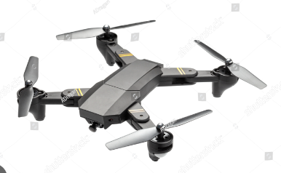
SYSTEM ARCHITECTURE
Live video feed captured
Data Processing
Human movement detection
Location of disaster place
Training YOLO Algorithm
Testing and Analysis

Slide 11
MODULES DESCRIPTION
Camera:
The camera module is responsible for capturing live video feed as the drone navigates disaster-stricken areas. It ensures that real-time footage of the environment is available for analysis by the system.
Live Video Feed Captured:
This module handles the processing of the live video feed captured by the camera. It ensures that the video feed is available for further analysis by other modules in the system.
Data Processing:
The data processing module is responsible for preprocessing the live video feed before it is input into the YOLO algorithm. It may involve tasks such as resizing, normalization, or other preprocessing techniques to optimize the data for object detection.
Training YOLO Algorithm:
This module involves training the YOLO algorithm on labeled datasets to enable it to accurately detect and track human movements in the disaster environment. Training involves optimizing the model's parameters and fine-tuning its architecture to achieve high accuracy.

Slide 12
MODULES DESCRIPTION
Testing and Analysis:
The testing and analysis module evaluates the performance of the entire system in simulated disaster scenarios. It involves conducting tests to assess the accuracy, speed, and reliability of the system in detecting and tracking human movements. Analysis of the test results helps identify areas for improvement and optimization.
Human Movement Detection:
This module utilizes the trained YOLO algorithm to detect and track human movements in real-time. It processes the preprocessed video feed and identifies human presence amidst rubble, debris, or hazardous environments.
Location of Disaster Place:
The location of the disaster place module utilizes the information gathered from human movement detection to pinpoint the location of survivors. It provides spatial coordinates or a map of the disaster area to guide first responders to the precise location of survivors for swift intervention and rescue operations.

Slide 13
ADVANTAGE
Rapid detection and identification of human movements in disaster zones.
Real-time monitoring capabilities enable immediate response and rescue efforts.
Enhanced situational awareness for first responders, leading to more effective decision-making.
Cost-effective solution compared to traditional search and rescue methods.
Minimizes risk to rescue personnel by providing remote reconnaissance capabilities

Slide 14
YOLO ALGORITHM
The YOLO (You Only Look Once) algorithm is a real-time object detection system that works by dividing an image into a grid and predicting bounding boxes and class probabilities for each grid cell.
The traditional object detection methods that rely on region proposals, YOLO predicts all bounding boxes directly in one pass through the neural network.
It uses a single convolutional neural network (CNN) to simultaneously predict multiple bounding boxes and their corresponding class probabilities.
By considering the entire image at once, YOLO is fast and efficient, making it suitable for real-time applications.
YOLO performs non-maximum suppression to remove duplicate detections and refine the final output.
This makes it a popular choice for various tasks, including human detection and tracking in disaster response scenarios.

Slide 15
SYSTEM REQUIREMENT
H/W SYSTEM CONFIGURATION:-
processor - Pentium – IV
RAM - 4 GB (min)
Hard Disk - 20 GB
S/W SYSTEM CONFIGURATION:-
Operating System : Windows 7 or 8
Frontend :HTML,CSS
Backend : python

Slide 16
MODULES
Camera
Live Video Feed Captured
Data Processing
Training Yolo Algorithm
Testing And Analysis
Human Movement Detection
Location Of Disaster Place

Slide 17
CAMERA
The camera module is the cornerstone of the AI-enabled drone system for disaster response, capturing live video feed as the drone navigates through disaster-stricken areas.
With advanced imaging technology, it records the surrounding environment in real-time, enabling the system to detect and track human movements amidst rubble, debris, or hazardous conditions.
To withstand environmental challenges like unstable structures and adverse weather, the camera must be rugged and resilient, ensuring uninterrupted data capture.
Its optics and resolution should be optimized for clear and detailed imagery, aiding accurate analysis by the system's algorithms.
The camera module should be flexible and adaptable to different disaster environments, with adjustable parameters such as focus, exposure, and frame rate to optimize image quality.
In dynamic and unpredictable scenarios, the camera provides critical real-time situational awareness to guide effective search and rescue efforts.

Slide 18
LIVE VIDEO FEED CAPTURED
The Live Video Feed Captured module is a critical component of the AI-enabled drone system, responsible for managing the incoming stream of video data from the drone's camera.
It processes the live feed, ensuring it's available for further analysis by other system modules.
This includes tasks like buffering, frame synchronization, and format conversion to prepare the data for analysis.
Once processed, the video feed is made available for real-time analysis by modules responsible for object detection, human movement tracking, and location identification.
By efficiently managing the flow of video data, this module ensures seamless system operation, providing timely and accurate information to support disaster response efforts.
It may also include features like data compression and quality-of-service mechanisms to optimize performance and respond rapidly to changing conditions in disaster areas.
The module plays a vital role in enhancing the effectiveness of the AI-enabled drone system in disaster response operations.

Slide 19
DATA PROCESSING
The Data Processing module is a crucial component of the AI-enabled drone system, responsible for preparing the live video feed captured by the camera for analysis by the You Only Look Once (YOLO) algorithm.
Its primary role is to preprocess the video data to optimize it for object detection. This involves tasks such as resizing, normalization, and other techniques to enhance the quality and suitability of the data for input into the YOLO algorithm.
By resizing video frames to a standard size and applying normalization techniques, the module ensures consistency and improves the algorithm's performance.
It may employ preprocessing techniques like noise reduction and contrast enhancement to improve clarity and accuracy.
These efforts help the YOLO algorithm accurately detect objects in disaster scenarios, enabling the drone system to provide valuable information for disaster response efforts.

Slide 20
TRAINING YOLO ALGORITHM
The Training YOLO Algorithm module is a critical stage in developing the AI-enabled drone system, focusing on enhancing the algorithm's ability to detect and track human movements accurately in disaster environments.
This module involves training the YOLO algorithm on labeled datasets containing examples of humans amidst rubble, debris, or hazardous conditions.
During training, the algorithm learns to recognize patterns distinguishing humans from other objects or background elements in the video feed.
Parameters and architecture are carefully optimized, adjusting factors like learning rate, batch size, and regularization techniques to achieve high accuracy in human movement detection.
The YOLO model's architecture may be customized to suit specific challenges of disaster scenarios, such as varying lighting conditions or cluttered environments.
The iterative training process continuously improves the algorithm's performance by feeding labeled data, allowing it to adapt to different disaster scenarios over time.
Continuous monitoring and evaluation ensure the algorithm achieves the desired level of accuracy and reliability for real-world deployment.
The Training YOLO Algorithm module enhances the AI-enabled drone system's capabilities for disaster response by enabling accurate real-time detection and tracking of human movements, supporting search and rescue efforts effectively.

Slide 21
HUMAN MOVEMENT DETECTION MODULE
The Human Movement Detection module is a crucial component of the AI-enabled drone system, responsible for utilizing the trained YOLO algorithm to detect and track human movements in real-time.
Building upon preprocessing by earlier modules, it takes the preprocessed video feed and applies the YOLO algorithm to identify human presence amidst rubble, debris, or hazardous environments.
In real-time operation, the module processes each frame of the video feed, leveraging the YOLO algorithm's object detection capabilities to identify and track human subjects.
By analyzing visual data for specific patterns and features associated with human movements, it accurately detects and monitors survivors in disaster areas.
Continuously analyzing the video feed, the module provides valuable information to first responders about survivor location and movements, aiding timely rescue efforts.
Its real-time operation ensures critical information is promptly available, enabling responders to prioritize areas for intervention and allocate resources effectively.

Slide 22
LOCATION OF DISASTER PLACE
The Location of Disaster Place module is a critical component of the AI-enabled drone system, responsible for pinpointing the exact location of survivors within the disaster area using information gathered from human movement detection.
It integrates data from the Human Movement Detection module with geographical information systems (GIS) or global positioning system (GPS) technology to accurately determine the spatial coordinates of detected human presence.
This module generates a real-time map of the disaster area, marking the locations where survivors have been detected and overlays this information onto digital maps accessible to first responders.
By providing accurate spatial information, it guides rescue teams to the precise locations of survivors, especially in complex and chaotic disaster environments.
This capability enhances the effectiveness of the AI-enabled drone system by enabling responders to quickly and accurately locate survivors, reducing response times and increasing the chances of successful rescues.

Slide 23
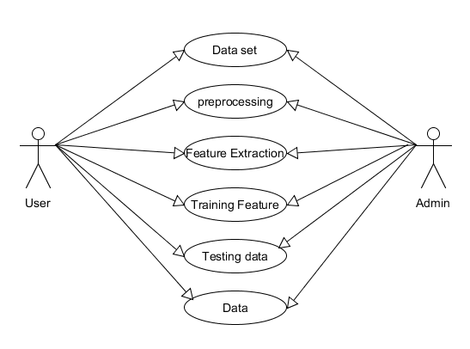
USE CASE DIAGRAM

Slide 24
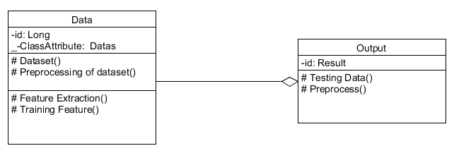
CLASS DIAGRAM

Slide 25
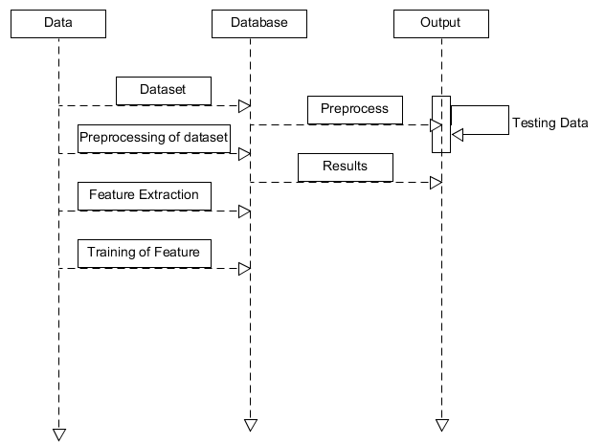
SEQUENCE DIAGRAM

Slide 26
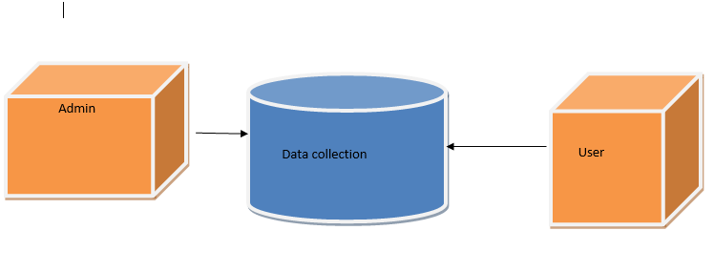
DATA FLOW DIAGRAM

Slide 27
CONCLUSION
In conclusion, the integration of AI-enabled drones utilizing the You Only Look Once (YOLO) algorithm presents a transformative solution for enhancing search and rescue operations in disaster scenarios. By harnessing the power of real-time object detection, this system offers unparalleled efficiency in identifying human movements amidst challenging environments. The agility, cost-effectiveness, and remote monitoring capabilities of the proposed drone system make it a valuable asset for disaster response teams. Moving forward, continued advancements in AI and drone technology hold the promise of further improving the effectiveness and reliability of such systems, ultimately saving more lives and mitigating the impact of disasters on communities worldwide.

Slide 28
FUTURE ENHANCEMENT
Continued advancements in AI algorithms, particularly in object detection techniques, can enhance the system's ability to detect and track human movements with greater accuracy and efficiency.
Developing autonomous navigation capabilities for drones can enable them to navigate complex disaster environments more effectively, including indoor areas or areas with limited GPS signal.
Improved communication systems, including better connectivity and bandwidth, can enable drones to relay real-time data more efficiently to disaster response teams, facilitating faster decision-making and coordination.
Implementing collaborative swarm systems where multiple drones work together can increase coverage area, redundancy, and overall system robustness in disaster scenarios.
Integrating the drone system with existing emergency response infrastructure, such as command centers and mapping systems, can streamline coordination and enhance the overall effectiveness of disaster response efforts.

Slide 29
REFERENCE
Khan, S. Gupta, and S. K. Gupta, “Emerging UAV technology for disaster detection, mitigation, response, and preparedness,” Journal of Field Robotics, vol. 39, no. 6, pp. 905–955, 2022.
Liu, W.; Quijano, K.; Crawford, M.M. YOLOv5-Tassel: Detecting Tassels in RGB UAV Imagery with Improved YOLOv5 Based on Transfer Learning. IEEE J. Sel. Top. Appl. Earth Obs. Remote Sens. 2022, 15, 8085–8094.
Gai, W.; Liu, Y.; Zhang, J.; Jing, G. An Improved Tiny YOLOv3 for Real-Time Object Detection. Syst. Sci. Control Eng. 2021, 9, 314–321
Karthi, M.; Muthulakshmi, V.; Priscilla, R.; Praveen, P.; Vanisri, K. Evolution of YOLO-V5 Algorithm for Object Detection: Automated Detection of Library Books and Performace Validation of Dataset. In Proceedings of the 2021 International Conference on Innovative Computing, Intelligent Communication and Smart Electrical Systems (ICSES), Chennai, India, 24–25 September 2021; IEEE: Piscataway, NJ, USA
Matinrad, N.; Reuter-Oppermann, M. A review on initiatives for the management of daily medical emergencies prior to the arrival of emergency medical services. Cent. Eur. J. Oper. Res. 2022, 30, 251–302.

